Slide 1
Business and Industrial Economics
Prof. Luca Grilli
Antitrust II

Slide 2
Merger regulation: Consumer Welfare (Not in the sense of the Chicago Law School view which may often refer to “consumer welfare” meaning in reality “total welfare”)
Nowadays, generally, the focus is on Consumer Welfare (i.e. Consumer Surplus) rather than on Total Social Welfare (i.e. Consumer Surplus + Producer Surplus)
The so-called Williamson’s Welfare trade-off model (American Economic Review, 1968) logic is usually not applied (neither in the U.S. nor in Europe, see Bet and Blair, 2019, for details about other institutional contexts).
In other words, any merging activity that is likely to bring allocative inefficiency is stopped despite of the extent of the gains in productive efficiency that may bring.

Slide 3
Merger regulation: Horizontal focus
Horizontal vs. Vertical or conglomerate mergers
Productive efficiency
Vs
Allocative efficiency
HORIZONTAL are the main focus (but not exclusive)
(see also Appendix 2 on Cournot oligopoly: more concentration = more mkt power)
From EU antitrust guidelines (art. 11, 12, 13, 2008/C 265/07): “Non-horizontal mergers are generally less likely to significantly impede effective competition than horizontal mergers. First, unlike horizontal mergers, vertical or conglomerate mergers do not entail the loss of direct competition between the merging firms in the same relevant market. As a result, the main source of anti-competitive effect in horizontal mergers is absent from vertical and conglomerate mergers. Second, vertical and conglomerate mergers provide substantial scope for efficiencies.”

Slide 4
Merger regulation: dynamic efficiency?
Historically, considerations related to dynamic efficiency were on the background and did not enter invasively into the decision.
See Denicolò and Polo (2019, Antitrust Law Journal): “[…] the literature has shown that competition may either increase or decrease innovation, depending on the circumstances. Significant progress has been made in identifying which circumstances are relevant, but a broad consensus is still lacking. In light of this, antitrust authorities have generally taken a cautious approach, limiting intervention mostly to cases in which the merging firms’ innovative products are close to commercialization (the “product pipeline”). In these cases, innovation outcomes have been regarded as predictable enough to be amenable to the standard, static analysis.”
This is probably still very much the case, even if things may change in the (near) future.
A decision in 2017 by EU antitrust has cleared the 130 Billion Euro merger between Dow/DuPont (agro-chemical sector) but only subject to structural remedies (i.e. the divestiture of major parts of DuPont's global pesticide business, including its global R&D organisation) on the argumented basis, then also formulated in the so-called “innovation theory of harm” (ITOH), that the eventual merger (without remedies) would have led (in the view of the EU Commission) to a significant decrease in the innovation rate among the involved parties that would exceed any possible gain in the other efficiency dimensions.
The ITOH has triggered an academic (surely not “ivory tower”) debate on the merits of this (new) approach in antitrust merger control, with many opponents, see Jullien/Lefouilli – Denicolò/Polo.

Slide 5
Merger regulation
Mergers are scrutinized only if they involve sufficiently big actors (ex-ante or ex-post). See EU thresholds in Appendix 1.
Why “smallness” is excluded?
+
Productive efficiency
=/+
Allocative efficiency
(potentially) win-win

Slide 6
Merger regulation (Horizontal)
Is (ex-post) largeness automatically punished in horizontal mergers?
Not really (rule of reason)
If synergies do exist, can productive efficiency be transferred at least in part to consumers (also more allocative efficiency) or at least can we be sure that competition in the mkt will not decrease?
Synergies? Economies of scale?
? (+/-)
? (+/-)
Allocative efficiency
Productive efficiency

Slide 7
Merger regulation: how it (generally) proceeds Note: Cabral (2018, p. 296): “In the US, the DOJ and the FTC lack the power to unilaterally prevent the merger from taking place. Normally, their threat of asking a court to do so is sufficient. […]. In Europe, both national agencies and the EU Commission have the power to block the merger.”
M&A exceeding a certain threshold have to be communicated in advance
Relevant market
If the M&A firms are not operating in the same market
Light Control/Consent decree (if no risk of foreclosure of rivals is present)
Horizontal M&A
Ascertained that productive efficiency gains do exist, is M&A leading to a dominant position or risking to seriously undermine competition?
Antitrust investigates
No: consent decree
Yes
Parties involvement
Antitrust believes that allocative efficiency would be seriously compromised if the focal M&A takes place
Decision: Denial (or Consent with structural and/or behavioral remedies)

Slide 8
Antitrust – open issues
AI and collusion
“First, pricing algorithms had once been based on pricing rules set by programmers but now often rely on AI systems that learn autonomously through active experimentation. After the programmer has set a goal, such as profit maximization, algorithms are capable of autonomously learning rules of conduct that achieve the goal, possibly with no human intervention. The enhanced sophistication of learning algorithms makes it more likely that AI systems will discover profit-enhancing collusive pricing rules, just as they have succeeded in discovering winning strategies in complex board games such as chess” (Calvano et al. 2020, p. 1040, Protecting consumers from collusive prices due to AI, Science, 370, 6520, pp. 1040-1042).
“The field of discussion is the one of collusion between firms. Any textbook of microeconomics explains how collusion produces a distortion in the market, resulting in a deadweight loss of efficiency and a reduction in consumer welfare. […] Should algorithmic collusion emerge in a market, society lacks an effective defense to stop it. Indeed, firms are, or declare themselves, unaware of collusion, while AI does not have a mind, a will, a consciousness. Therefore, there can be no “meeting of minds” in the collusion between algorithms” (Mariotti 2021, Forging a new alliance between economics and engineering, Journal of Industrial and Business Economics, 48, pp. 551-572).

Slide 9
Antitrust – open issues
M&A control and big-tech (killer?) acquisitions
Killer acquisitions may fall below thresholds: Need of new ones? Not simply based on turnover (e.g. acquisition price)? Obligation to communicate (and scrutinize) every M&A for big tech companies? But how to assess the competitive threat of a start-up?
Lina Khan - the present chairwoman of the FTC - in one of the seminal article of the new Brandeis Movement (Amazon’s Antitrust Paradox, The Yale Law Journal) proposes a “prophylactic ban” for digital giants (i.e. no M&A activity whatsoever).
Is “digital” special and requires a specific attention?
The EU Commission has answered “yes” with the very recent issue of the Digital Market Act (DMA), which aims at identifying “Gatekeepers” (basically GAFAM or MAMAA) and forcing them to a series of “dos and don’ts”.
See the link reported in the previous lecture on Antitrust I (slide n. 3) or a rapid Q&A version of DMA in: https://ec.europa.eu/commission/presscorner/detail/en/QANDA_20_2349.
(In-)Adequacy of sanctions

Slide 10
References
https://ec.europa.eu/competition-policy/index_en
Further reading:
Cabral, Introduction to Industrial Organization, 2000, I edition, chapters 8 and 15.2, 15.3 [2018, II edition, chapter 9, 11 and 12.3] .
Besanko et al., The Economics of Strategy, chapter 5, pp. 166-167 (SSNIP test)

Slide 11
APPENDIX 1
FURTHER DETAILS ON M&A CONTROL IN EU

Slide 12
M&A control in the EU (“as is” vs. “as if”)
From EU antitrust guidelines
“In assessing the competitive effects of a merger, the Commission compares the competitive conditions that would result from the notified merger with the conditions that would have prevailed without the merger.
In most cases the competitive conditions existing at the time of the merger constitute the relevant comparison for evaluating the effects of a merger.
However, in some circumstances, the Commission may take into account future changes to the market that can reasonably be predicted. It may, in particular, take account of the likely entry or exit of firms if the merger did not take place when considering what constitutes the relevant comparison”

Slide 13
M&A control in the EU (thresholds)
The Commission in principle only examines larger mergers with an EU dimension, meaning that the merging firms reach certain turnover thresholds. There are two alternative ways to reach turnover thresholds for EU dimension.
The first alternative requires:
(i) a combined worldwide turnover of all the merging firms over €5 000 million, and
(ii) an EU-wide turnover for each of at least two of the firms over €250 million.
The second alternative requires:
(i) a worldwide turnover of all the merging firms over €2 500 million, and
(ii) a combined turnover of all the merging firms over € 100 million in each of at least three Member States,
(iii) a turnover of over €25 million for each of at least two of the firms in each of the three Member States included under ii, and
(iv) EU-wide turnover of each of at least two firms of more than €100 million.
In both alternatives, an EU dimension is not met if each of the firms archives more than two thirds of its EU-wide turnover within one and the same Member State. About 300 mergers are typically notified to the Commission each year.
Smaller mergers which do not have an EU dimension may fall instead under the remit of Member States' competition authorities. There is a referral mechanism in place which allows the Member States and the Commission to transfer the case between themselves, both at the request of the companies involved and of the Member States. This allows the companies to benefit from a one-stop-shop review and to allocate the case to the most appropriate authority.

Slide 14
APPENDIX 2
CONCENTRATION AND MKT POWER

Slide 15
Classification of market structures
From Lecture 2a
P.c.
Potential competition
Oligopoly
Dominant firm
Monopoly
Monopolistic competition
Market power
Note
As we know in presence of barriers to entry (and exit) and homogenous goods mkt power increases with market concentration.
See next slides to see formally how the Cournot game leads towards competitive outcomes when the number of players increases.

Slide 16
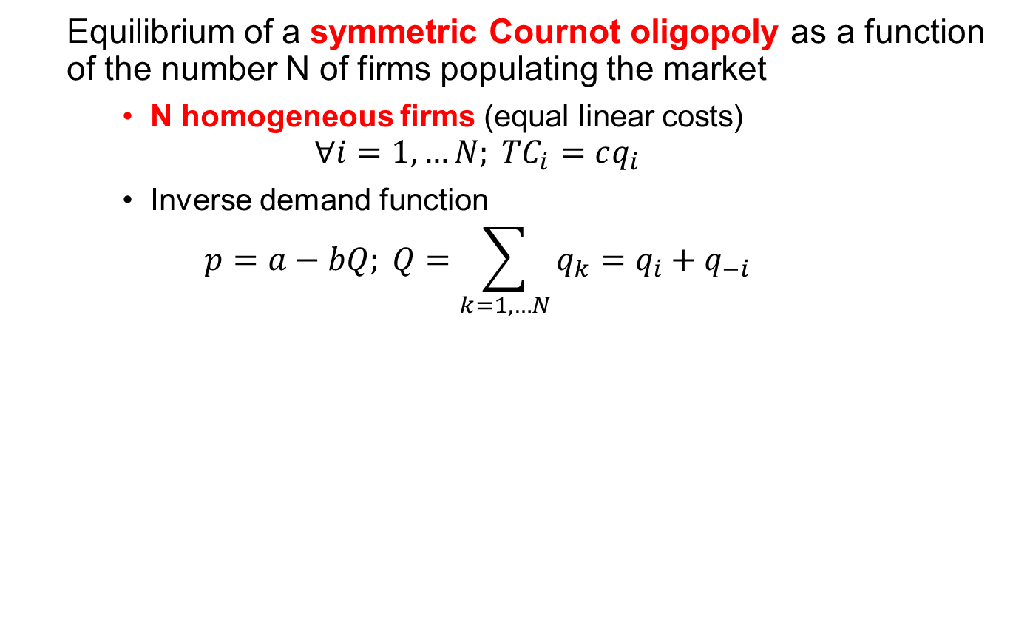
Cournot with N firms
Equilibrium of a symmetric Cournot oligopoly as a function of the number N of firms populating the market
N homogeneous firms (equal linear costs)
$$∀i=1, …N; {TC}_{i}=cq_{i}$$
Inverse demand function
$$p=a−bQ; Q=\sum_{k=1, …N}{q_{k}=q_{i}+q_{−i}}$$

Slide 17
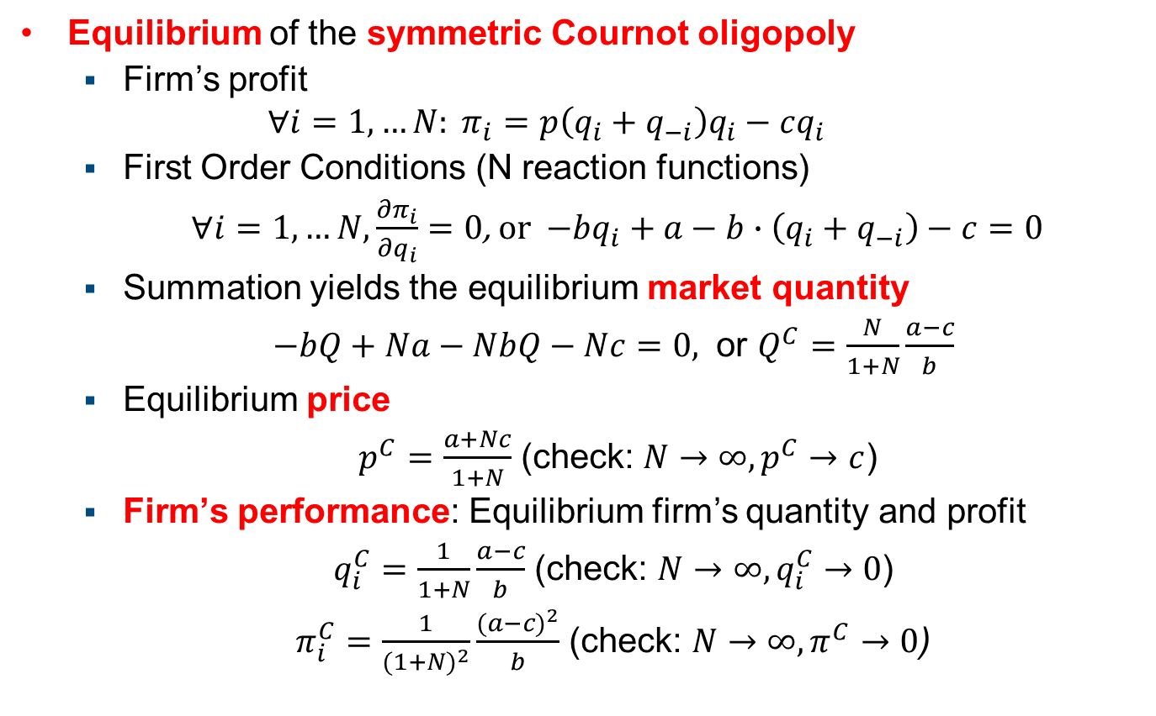
Cournot with N firms
Equilibrium of the symmetric Cournot oligopoly
Firm’s profit
$$∀i=1, …N: π_{i}=p\left(q_{i}+q_{−i}\right)q_{i}−cq_{i}$$
First Order Conditions (N reaction functions)
$∀i=1, …N, \frac{∂π_{i}}{∂q_{i}}=0$, or $−bq_{i}+a−b∙\left(q_{i}+q_{−i}\right)−c=0$
Summation yields the equilibrium market quantity
$−bQ+Na−NbQ−Nc=0,$ or $Q^{C}=\frac{N}{1+N}\frac{a−c}{b}$
Equilibrium price
$p^{C}=\frac{a+Nc}{1+N}$ (check: $N→∞, p^{C}→c$)
Firm’s performance: Equilibrium firm’s quantity and profit
$q_{i}^{C}=\frac{1}{1+N}\frac{a−c}{b}$ (check: $N→∞, q_{i}^{C}→0$)
$π_{i}^{C}=\frac{1}{(1+N)^{2}}\frac{(a−c)^{2}}{b}$ (check: $N→∞, π^{C}→0$)

